Slide 1
COACH’S MEETING
2017 Spring Season

Slide 2
AGENDA
Meet the board
Club Affiliations
Calendar
Rules of Play and Code of Ethics
Coaching Notes
Player and Field Safety
Field Status
Volunteer Opportunities

Slide 3
AMELIA ISLAND YOUTH SOCCER BOD
Jay Denison
President
Open
Vice President
Open
Treasurer
Andy Godek Secretary
Ron Acker
Dir of Competition
Stacy Hanna Registrar
Aaron Opheim
U6/8 Recreational Dir
Ethan Dombkowski
U10/12 Recreational Dir
Andy Francis
Director of Coaching
Julie Nadeau
Director of Referees
OPEN
Director of Facilities
OPEN
Director of Volunteers
OPEN
Director Fund Raising & Marketing
Shelly Domingo
Director of Public Relations
Lisa Emerson
Director of Team Managers

Slide 4
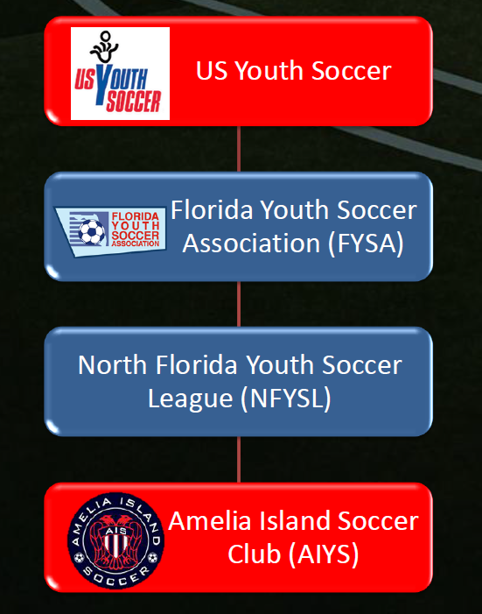
AFFILIATIONS

Slide 5
CALENDAR EVENTS
Field Day: February 18, AIYS Fields 8-12am
Sign up online to receive credit for volunteer hours
Picture Day: TBD
Opening Day: March 11
End of Season: May 13
Summer Camp: July 10-14

Slide 6
Rules of Play
Conform to FIFA Laws of the Game and US Youth Soccer Rules
U13 and under: Small Side Game Rules
http://www.nfysl.com/images/FAQ_Small.PDF
U14 and above: FIFA
Available on Homepage or US Youth Soccer
The biggest change this year will be the 2017 Player Developmental Initiatives and concussion initiative.
See usyouthsoccer.org/coaches/smallsidedgames/

Slide 7
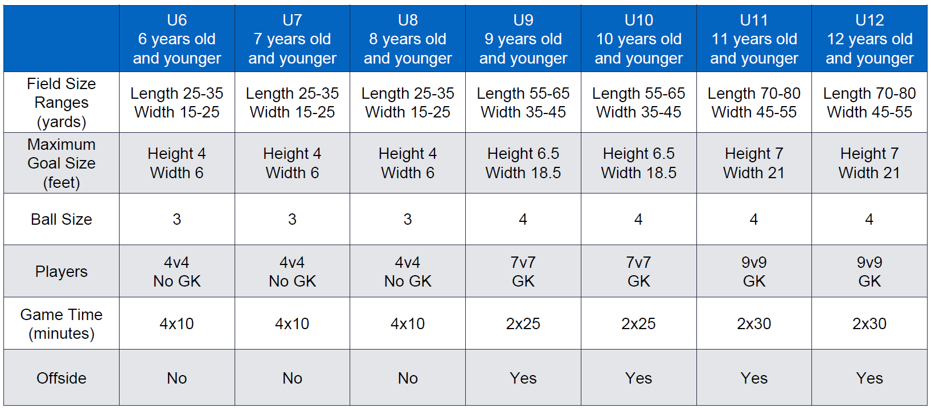
Small Sided Game Chart

Slide 8
FYSA CODE OF ETHICS
FYSA Rules dictate that the Coach is responsible for parents/spectator conduct during games
Failure to control conduct during the game may result in you being disciplined
If you need assistance, contact a board member
Be a model of and teach respect
Referees
Opposing teams
Spectators
You, the coach, set the example for players and parents

Slide 9
FYSA CODE OF ETHICS
Red Cards
Player must serve the suspension
Coach responsibility
Failure may result in a 12 month suspension
Disciplinary Actions
Handle by Disciplinary Committee chaired by VP as outlined in bylaws

Slide 10
COACH’S NOTES
Head & Assistant Coach and TA
Background checks
CDC heads up training
Team Administrator
Medical release forms
Roster & Player cards ***(all travel teams need picture in Got soccer)
Practice times & Equipment
Sign up today for practice times and days
U6 30 min practice
U8/U10 60 min practice 1 day a week
All other 2 days a week (90 min max)

Slide 11
NOTES
Game Day Scheduling
U6 and U8 in-house Saturday
U10 in-house and Camden
Start Time 9am-12pm
Will play 3-4 games against Camden Georgia teams
U12 & Up play NFYSL schedule
Most games will be on Saturday with a possibility some Sundays.
Playing Time ( 50 / 50)

Slide 12
TEAM ADMINISTRATOR
Each team needs one to support the coach and the team
Point of contact concerning questions and administrative stuff
Let the coach coach and let the TA answer questions about schedule, snacks duty, what color uniform to wear (hint: always have both jerseys), what field the game is on, directions to fields, etc.
Communication will be coming from TA (ideally)

Slide 13
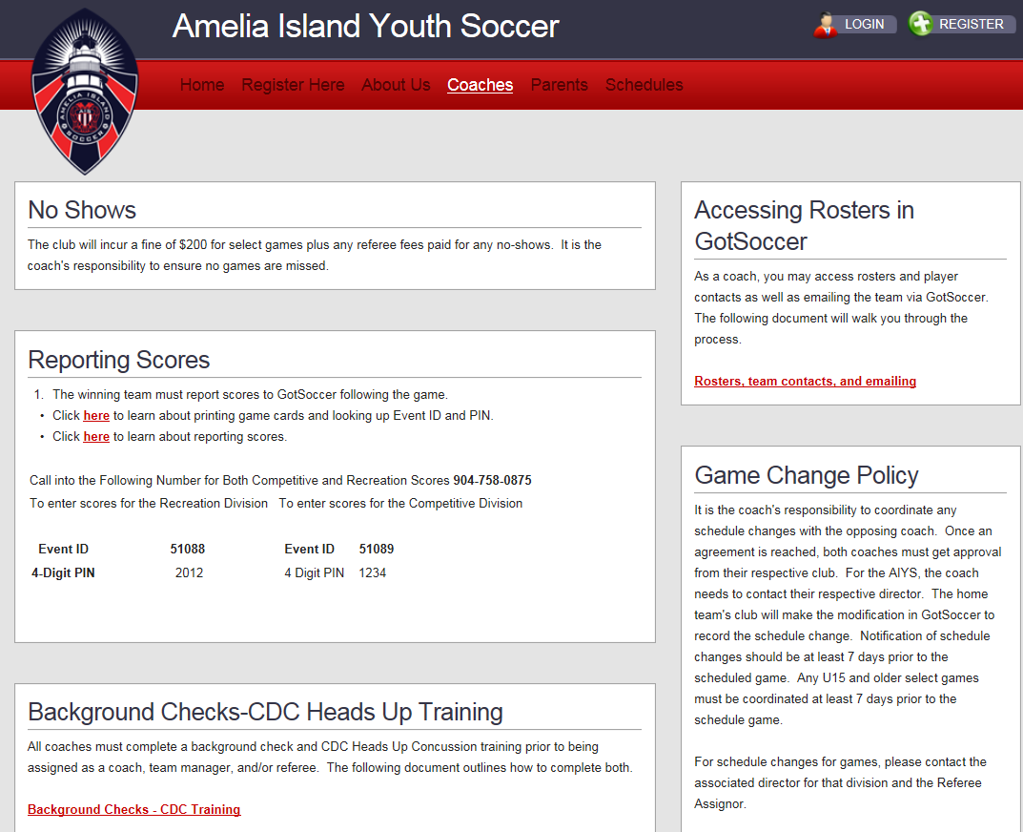
WEB SITE COACH CORNER

Slide 14
FIELD SAFETY

Slide 15
VOLUNTEER’S

Slide 16
Question

